Slide 1
Unit 10: Introduction to OpenGL

Slide 2
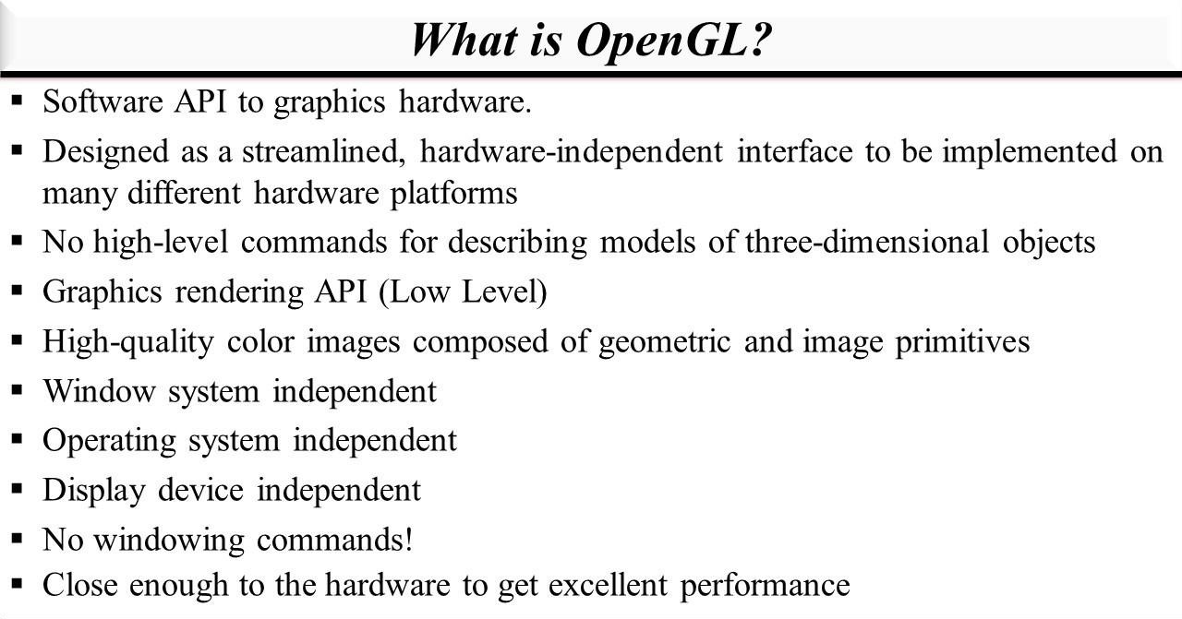

Slide 3
Introduction
OpenGL (Open Graphics Library) is a cross-platform, hardware-accelerated, language-independent, industrial standard API for producing 3D (including 2D) graphics.
Modern computers have dedicated GPU (Graphics Processing Unit) with its own memory to speed up graphics rendering. OpenGL is the software interface to graphics hardware.
In other words, OpenGL graphic rendering commands issued by your applications could be directed to the graphic hardware and accelerated.
We use 3 sets of libraries in our OpenGL programs:
1.Core OpenGL (GL): consists of hundreds of commands, which begin with a prefix "gl" (e.g. glColor, glVertex, glTranslate, glRotate). The Core
OpenGL models an object via a set of geometric primitives such as point, line and polygon.

Slide 4
OpenGL Utility Library (GLU): built on-top of the core OpenGL to provide important utilities (such as setting camera view and projection) and more building models (such as qradric surfaces and polygon tessellation). GLU commands start with a prefix "glu" (e.g., gluLookAt, gluPerspective).
OpenGL Utilities Toolkit (GLUT): OpenGL is designed to be independent of the windowing system or operating system. GLUT is needed to interact with the Operating System (such as creating a window, handling key and mouse inputs); it also provides more building models (such as sphere and torus). GLUT commands start with a prefix of "glut" (e.g., glutCreatewindow, glutMouseFunc). GLUT is platform independent, which is built on top of platform-specific OpenGL extension such as GLX for X Window System, WGL for Microsoft Window, and AGL, CGL or Cocoa for Mac OS. Quoting from the opengl.org: "GLUT is designed for constructing small to medium sized OpenGL programs. While GLUT is well-suited to learning OpenGL and developing simple OpenGL applications, GLUT is not a full-featured toolkit so large applications requiring sophisticated user interfaces are better off using native window system toolkits. GLUT is simple, easy and small."

Slide 5
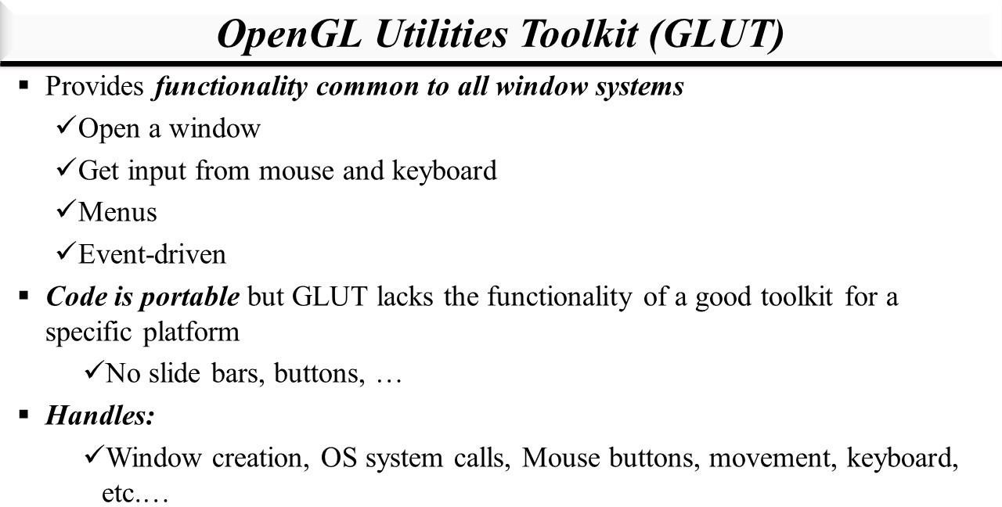

Slide 6
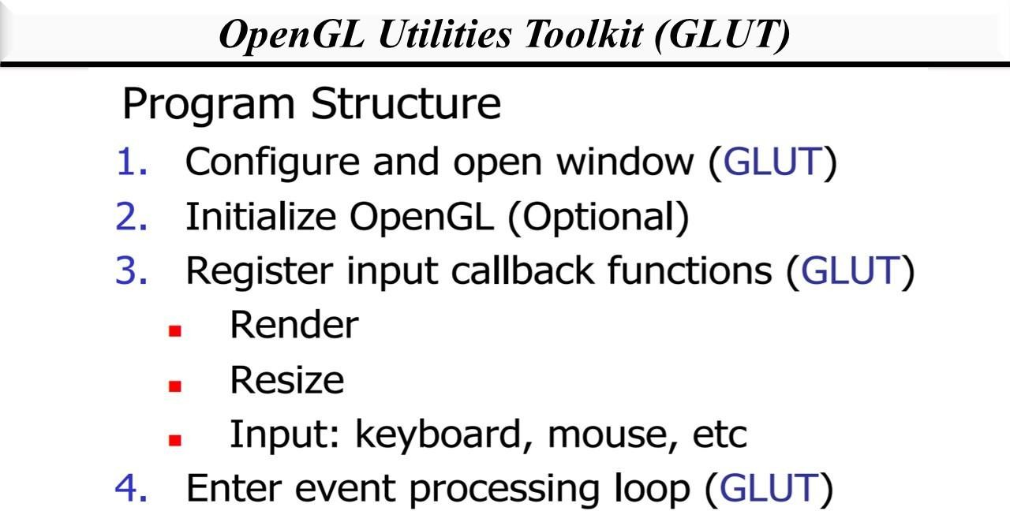

Slide 7
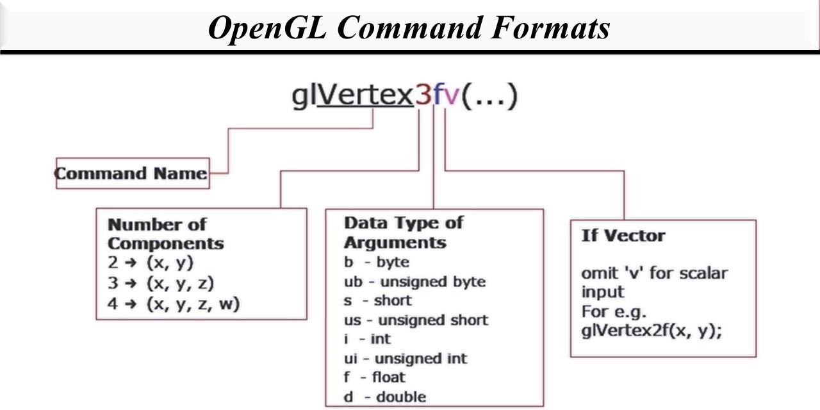

Slide 8
4.OpenGL Extension Wrangler Library (GLEW): "GLEW is a cross-platform open-source C/C++ extension loading library. GLEW provides efficient run-time mechanisms for determining which OpenGL extensions are supported on the target platform." Source and pre-build binary available at http://glew.sourceforge.net/. A standalone utility called "glewinfo.exe" (under the "bin" directory) can be used to produce the list of OpenGL functions supported by your graphics system.
OpenGL as a State Machine
OpenGL operates as a state machine, and maintain a set of state variables (such as the foreground color, background color, and many more).
In a state machine, once the value of a state variable is set, the value persists until a new value is given.
For example, we set the "clearing" (background) color to black once in initGL().
We use this setting to clear the window in the display() repeatedly (display() is called back whenever there is a window re-paint request) – the clearing color is not changed in the entire program.

Slide 9
Another example: If we use glColor function to set the current foreground color
to "red", then "red" will be used for all the subsequent vertices, until we use another glColor function to change the foreground color.
In a state machine, everything shall remain until you explicitly change it!

Slide 10
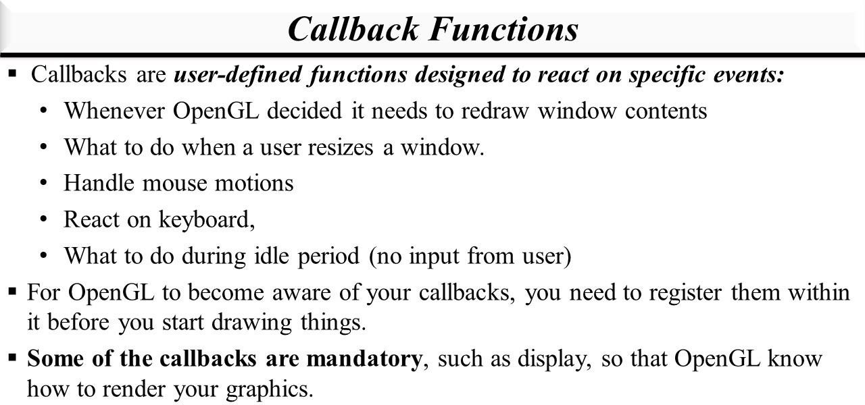

Slide 11
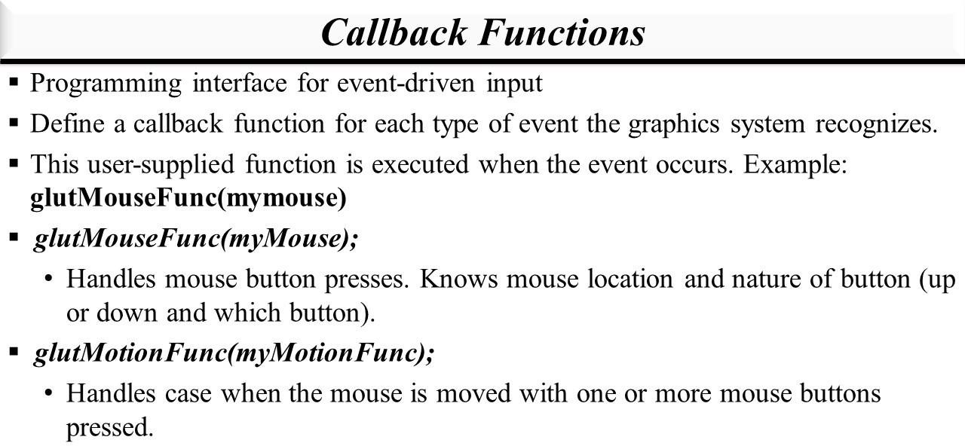

Slide 12
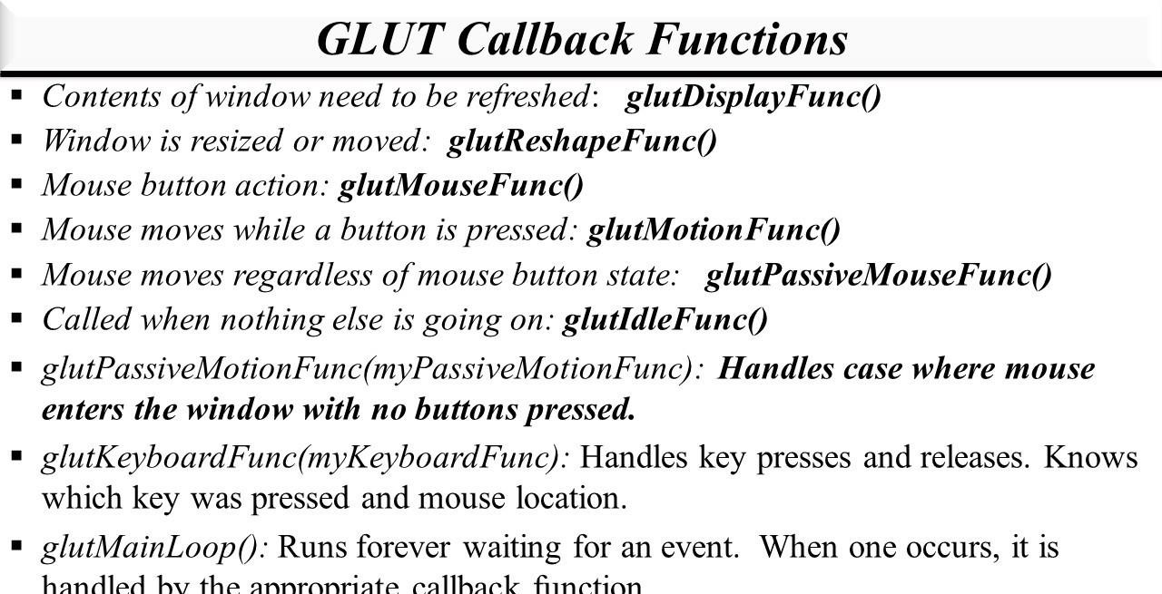

Slide 13
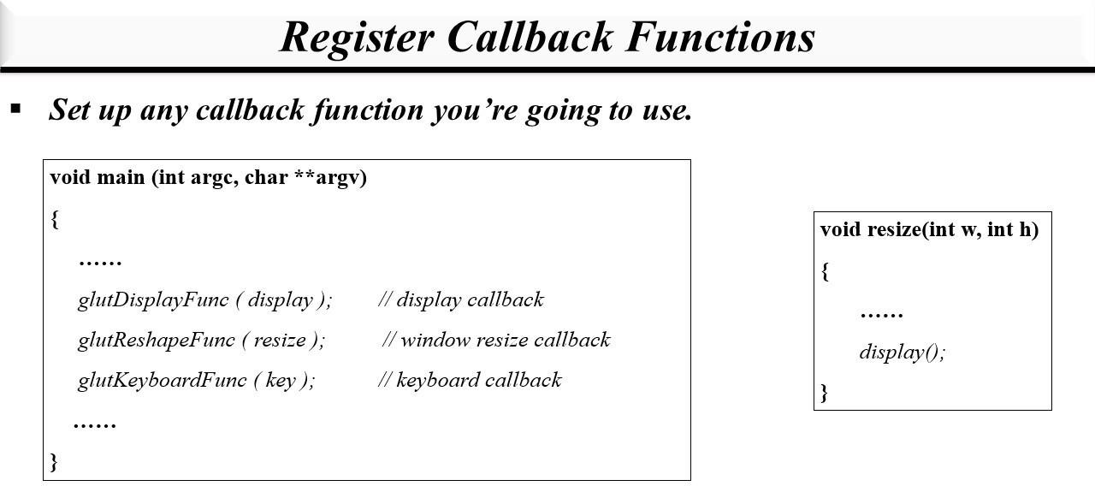

Slide 14
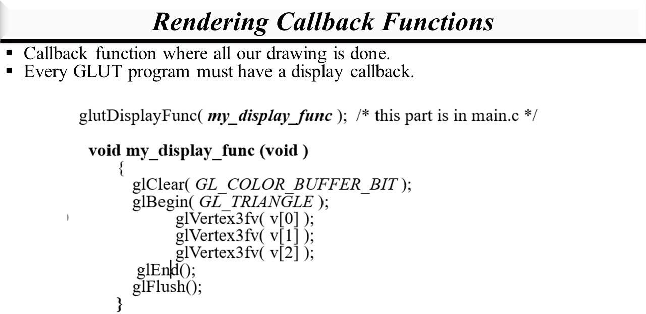

Slide 15
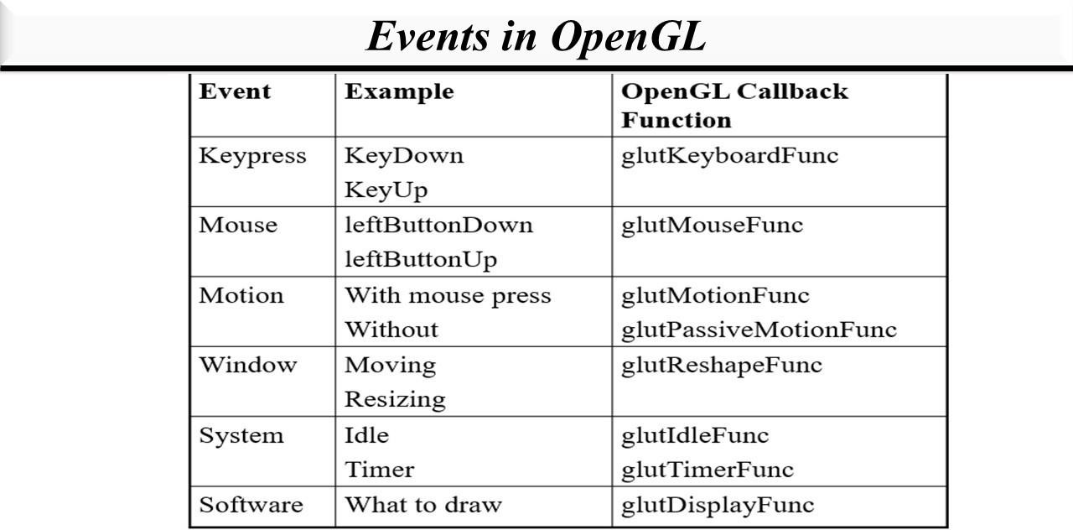

Slide 16
Basic Lighting in OpenGL
Lighting in the real world is incredibly complex, influenced by numerous factors that are challenging to compute with limited processing power. In OpenGL, we rely on simplified models that approximate reality and are easier to process. One such model is the Phong lighting model.
The Phong model comprises three essential components:
Ambient Lighting: Even in darkness, there’s usually some scattered light (from the moon or distant sources). To simulate this, we use an ambient lighting constant that gives objects a base color. It ensures that objects are never completely dark.
Diffuse Lighting: This component simulates the directional impact of light on an object. It’s visually significant—the more a part of an object faces the light source, the brighter it becomes.
Specular Lighting: Shiny objects exhibit bright spots when illuminated. Specular highlights are influenced more by the light color than the object color.

Slide 17
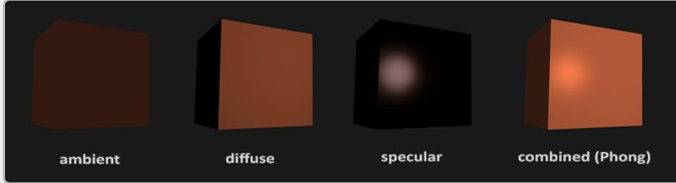
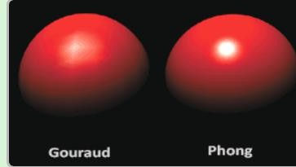
d

Slide 18
Polygons using OpenGL
It all begins with the vertices, these are the points from which shapes like triangles will later be constructed. Each of these points is stored with certain attributes and it's up to you to decide what kind of attributes you want to store. Commonly used attributes are 3D position in the world and texture coordinates.
The vertex shader is a small program running on your graphics card that processes every one of these input vertices individually. This is where the perspective transformation takes place, which projects vertices with a 3D world position onto your 2D screen! It also passes important attributes like color and texture coordinates further down the pipeline.
After the input vertices have been transformed, the graphics card will form triangles, lines or points out of them. These shapes are called primitives because they form the basis of more complex shapes. There are some additional drawing modes to choose from, like triangle strips and line strips. These reduce the number of vertices you need to pass if you want to create objects where each next primitive is connected to the last one, like a continuous line consisting of several segments.

Slide 19
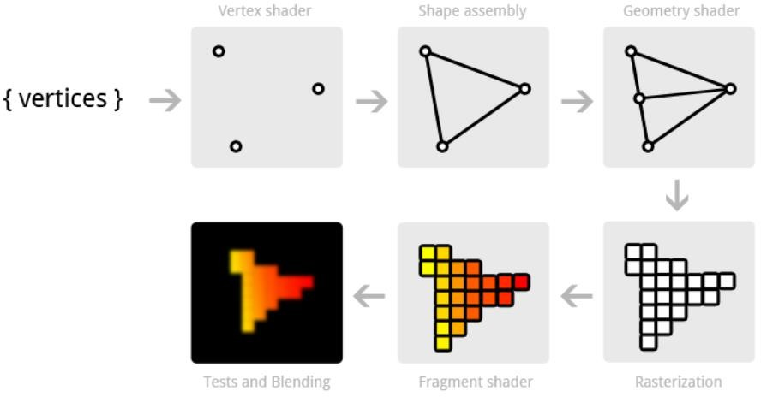

Slide 20
Color commands
The RGB color model is commonly used in computer graphics. It stands for red, green, and blue, which are the additive primary colors.
Each color component (red, green and blue) is assigned a value between 0 and 1.
For example:
Pure red: (1, 0, 0)
Full blue: (0, 0, 1)
White: (1, 1, 1)
Black: (0, 0, 0)
Yellow: (1, 1, 0)
The glColor3f function sets the current drawing color.
It takes three arguments: the red, green, and blue components of the desired color.
After calling glColor3f, everything drawing will be in that color.

Slide 21
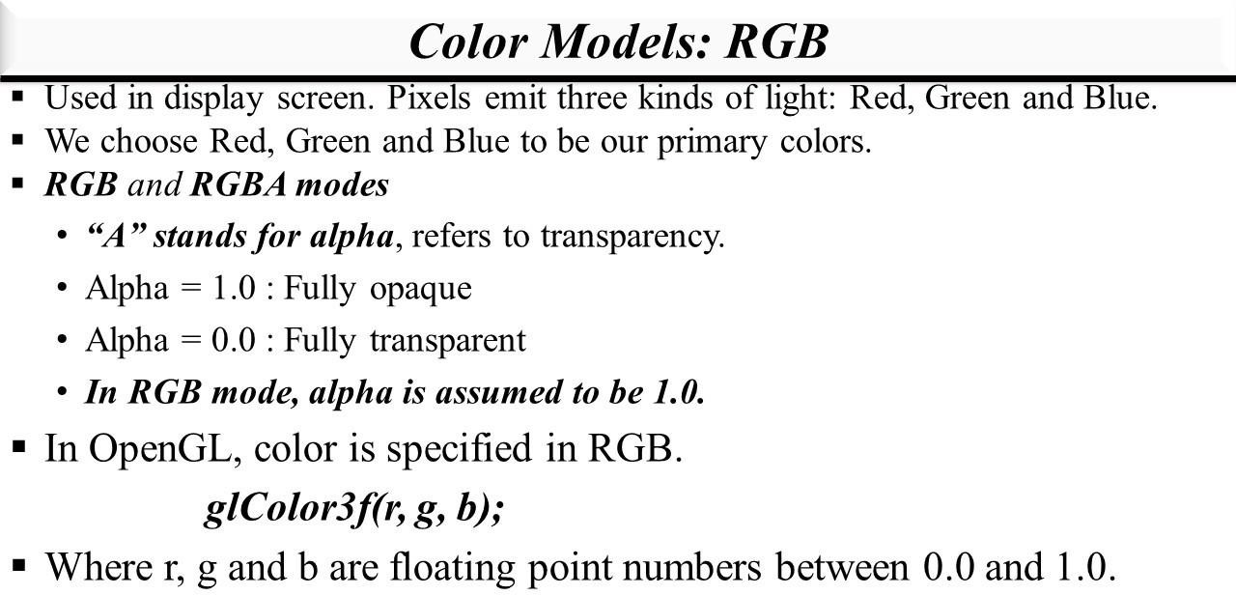

Slide 22
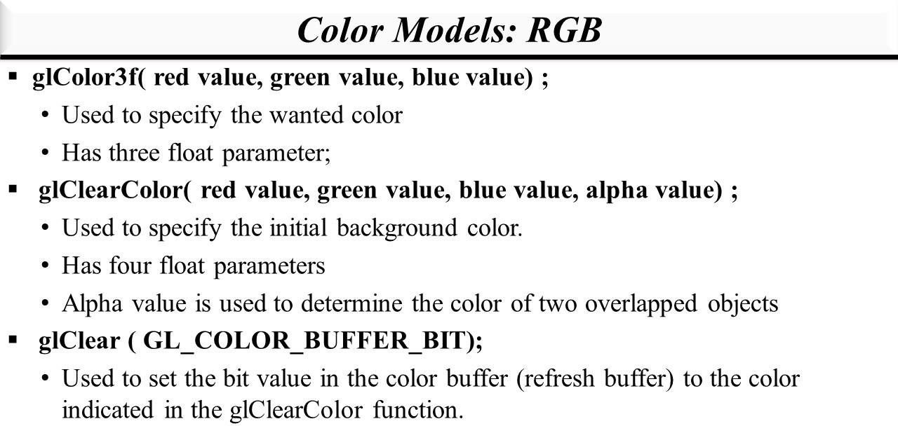

Slide 23
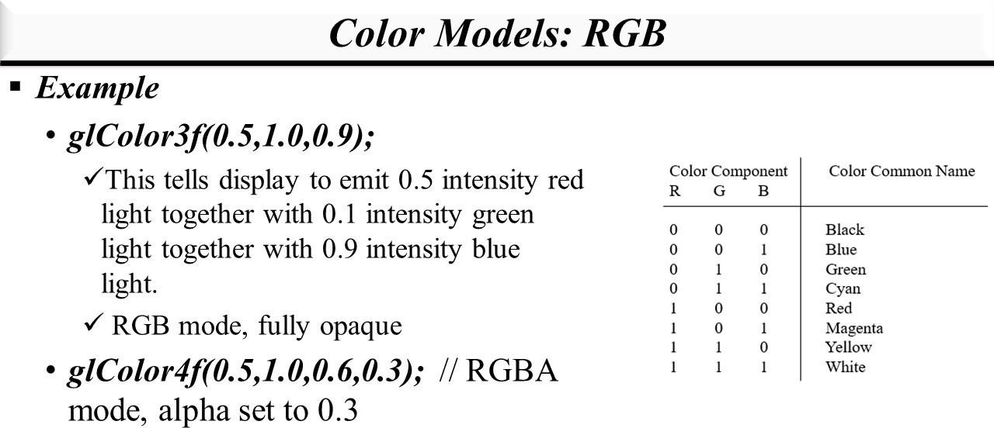

Slide 24
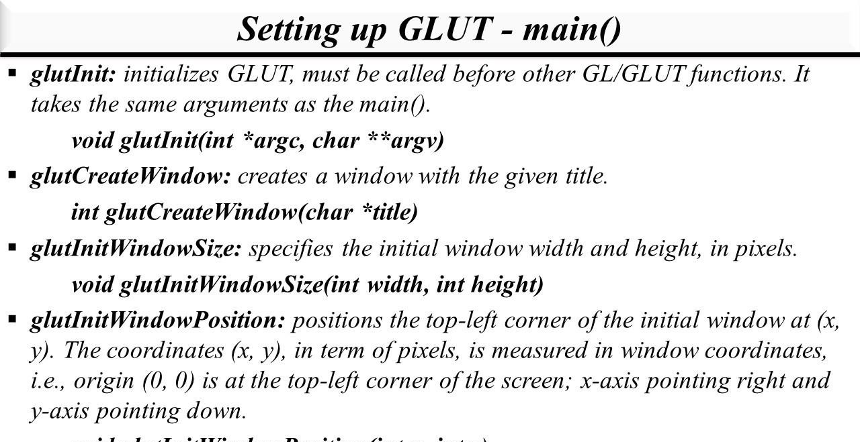

Slide 25
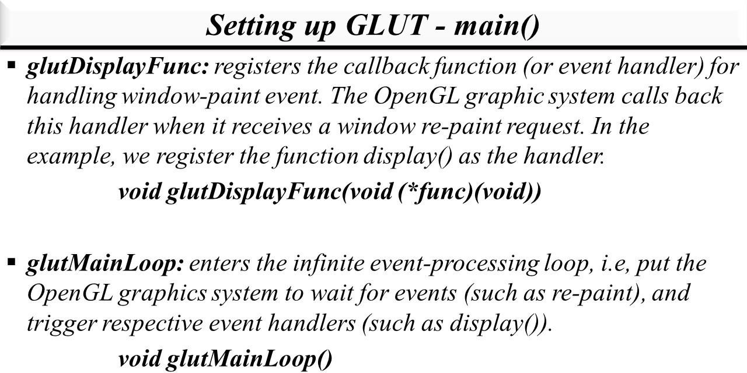

Slide 26
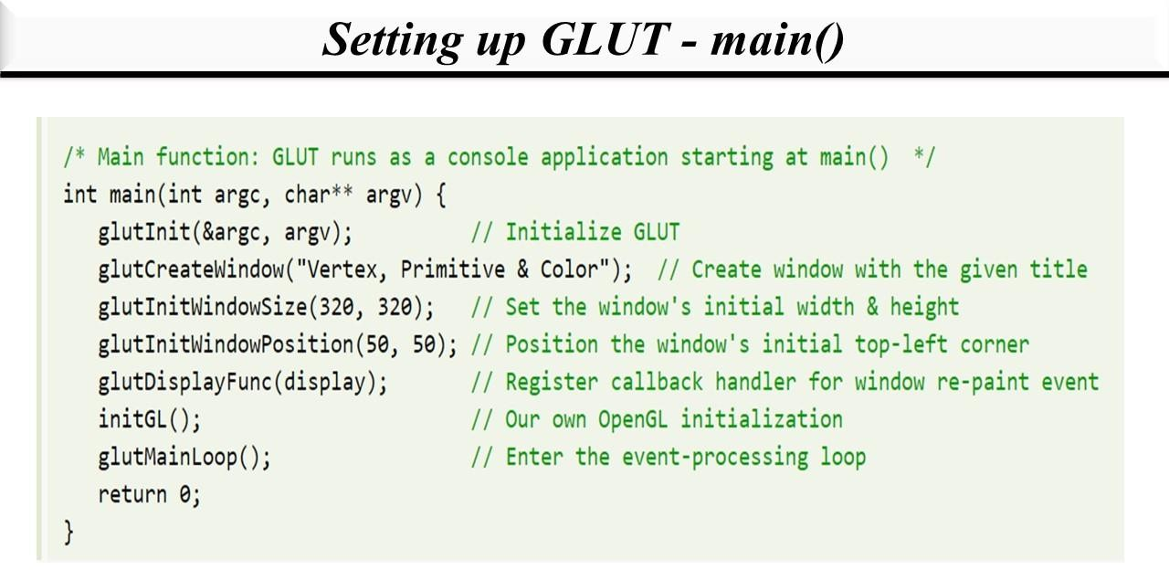

Slide 27
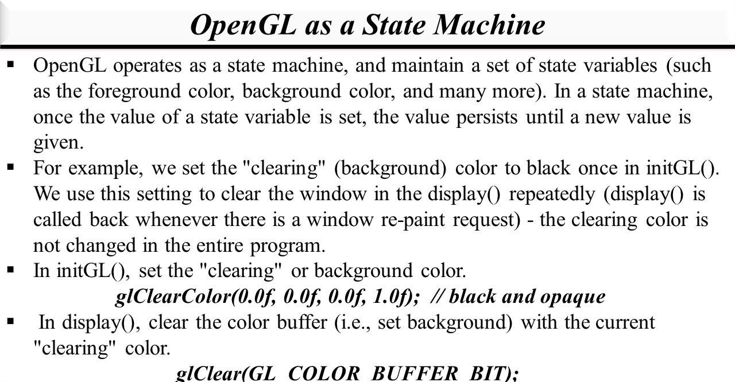

Slide 28
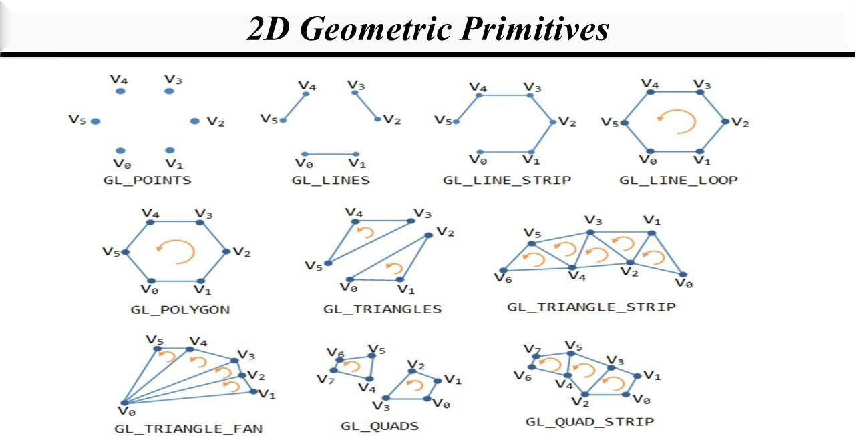

Slide 29
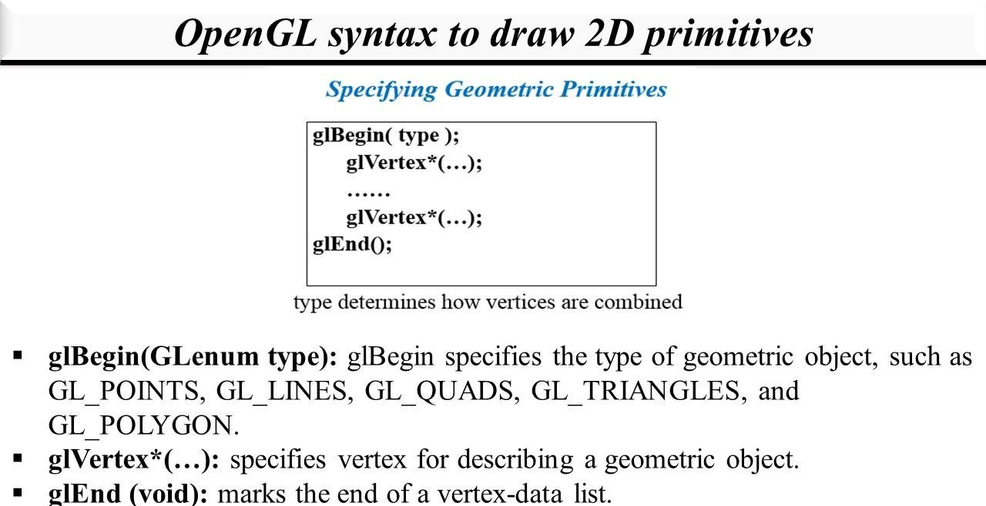

Slide 30
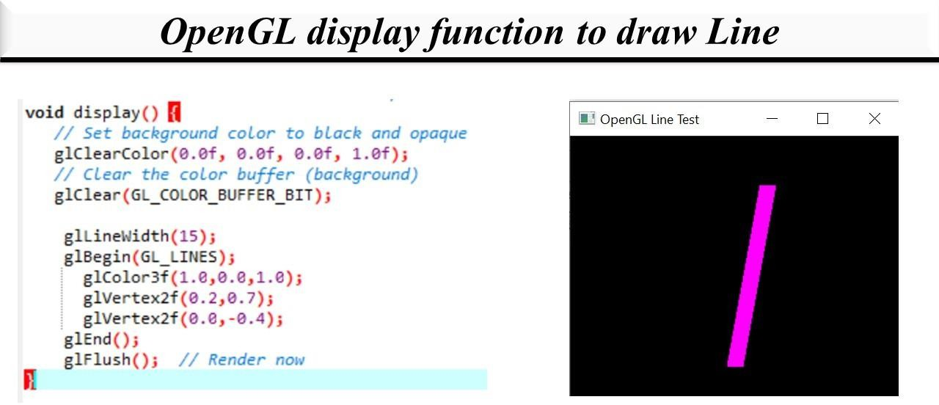

Slide 31
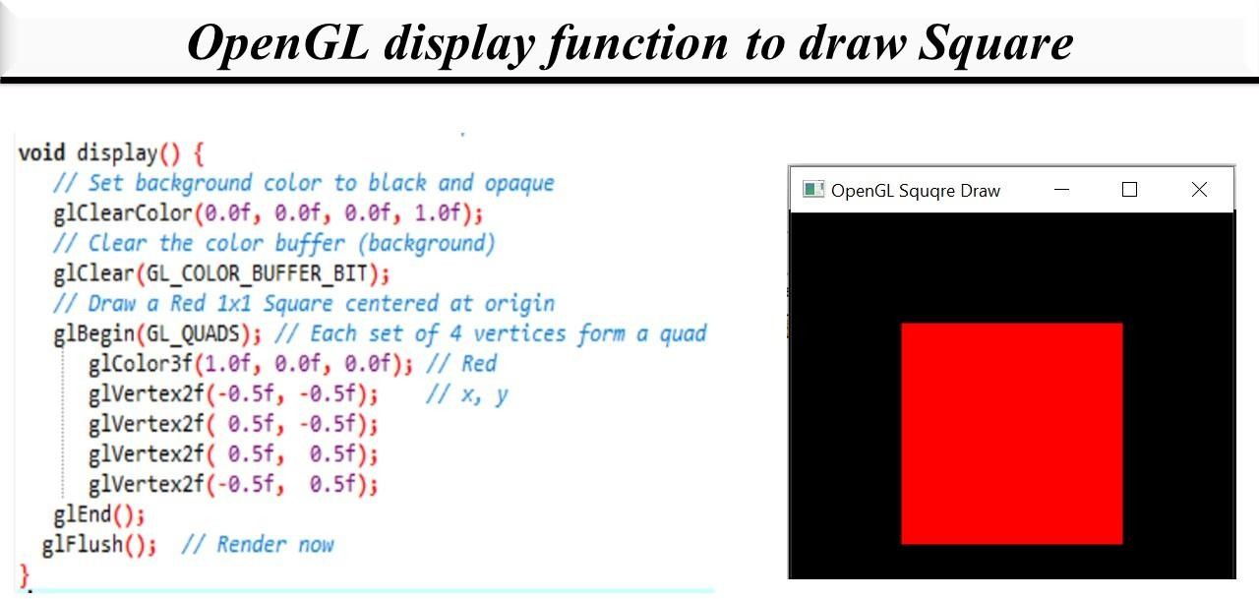

Slide 32
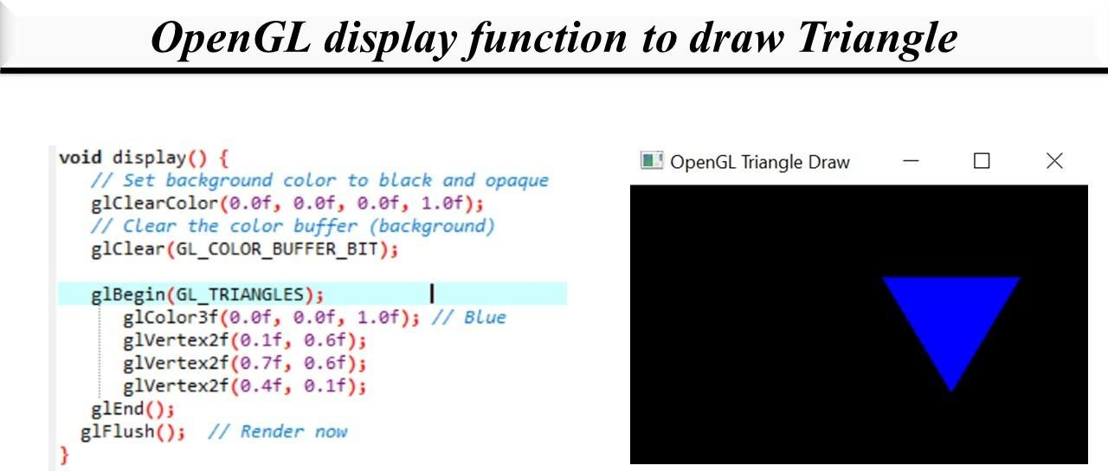

Slide 33
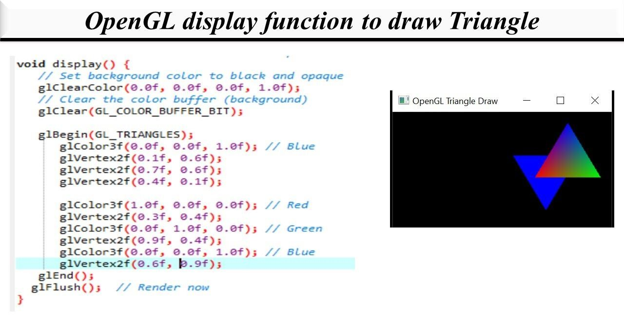

Slide 34
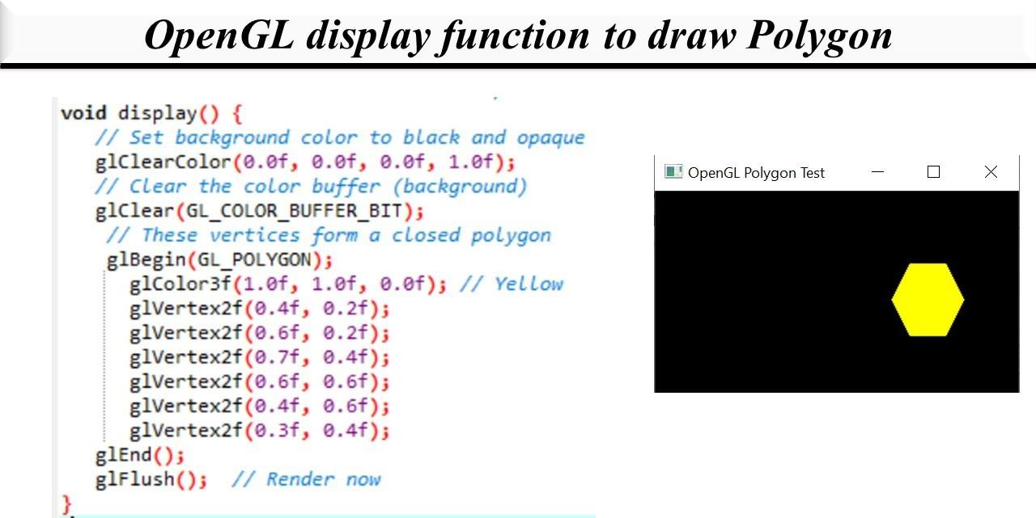

Slide 35
Thank you

